Slide 1


Introduction to M Commerce
M Commerce
Prepared By: Kabya Thapa
Grade: 12-D
Roll no: 19

Slide 2
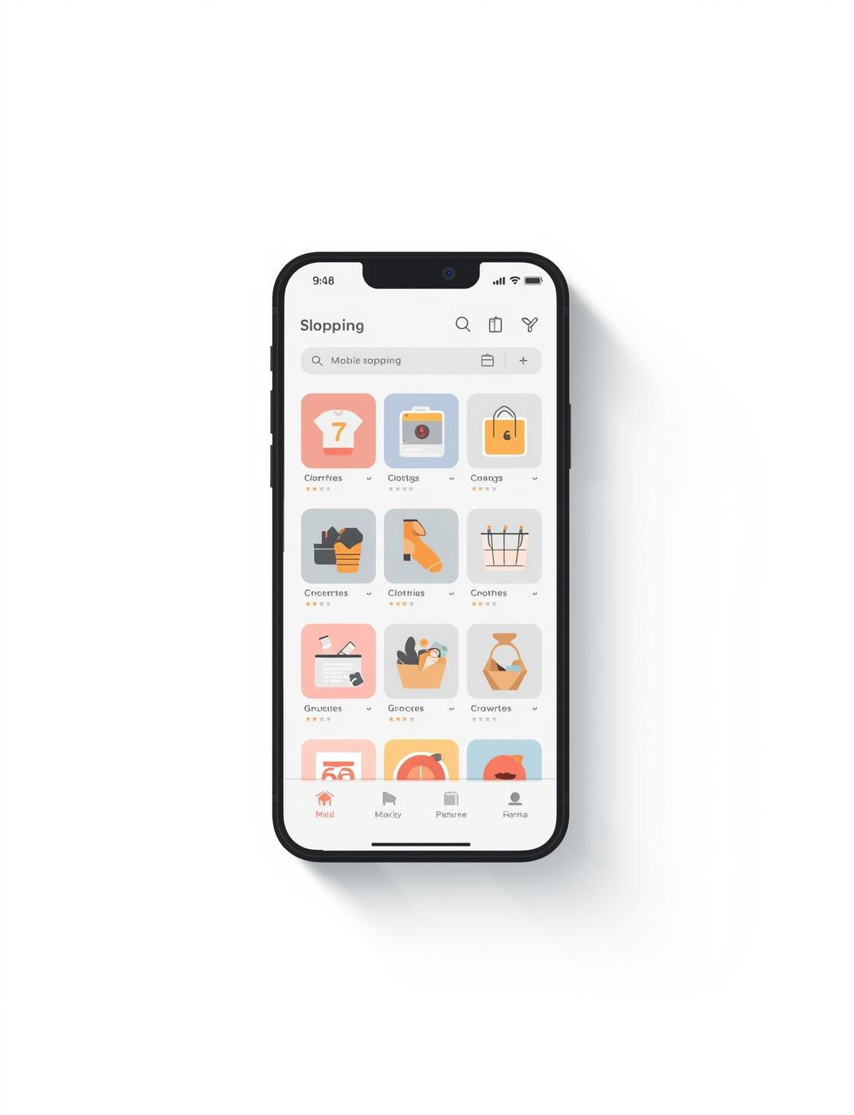
What is M Commerce?
Buying and selling using mobile devices
Uses smartphones and tablets
Works through apps and mobile websites

Slide 3
Mobile Commerce Share
Online Sales Growth
"50%"
"25%"
Represents mobile's significant role in e-commerce growth.
Indicates the annual increase in mobile commerce sales.

Slide 4

Key Features
Essential aspects of M Commerce
  Mobility and portability
  Fast and easy transactions
  Multiple mobile payment options
  Instant notifications and updates

Slide 5
Benefits of M Commerce
Key Advantages for Businesses and Consumers
  Convenient and time-saving
  Can be used anytime, anywhere
  Supports cashless payments
  Helps in businesses reach more customers

Slide 6
Challenges in M Commerce
Key obstacles facing mobile commerce
  Security and privacy risks
  Internet connectivity issues
  Small screen size limitations
  High risk of payment fraud
  Lack of technical knowledge

Slide 7
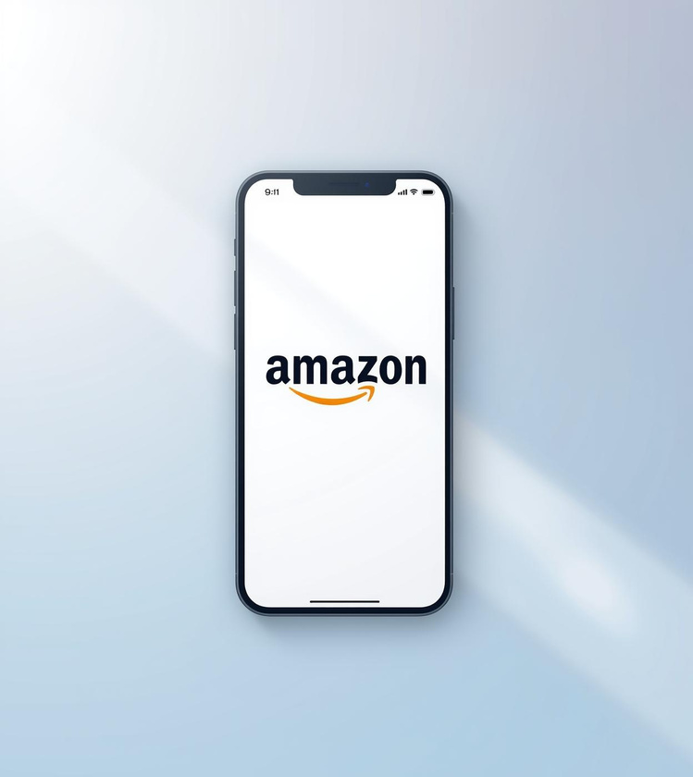
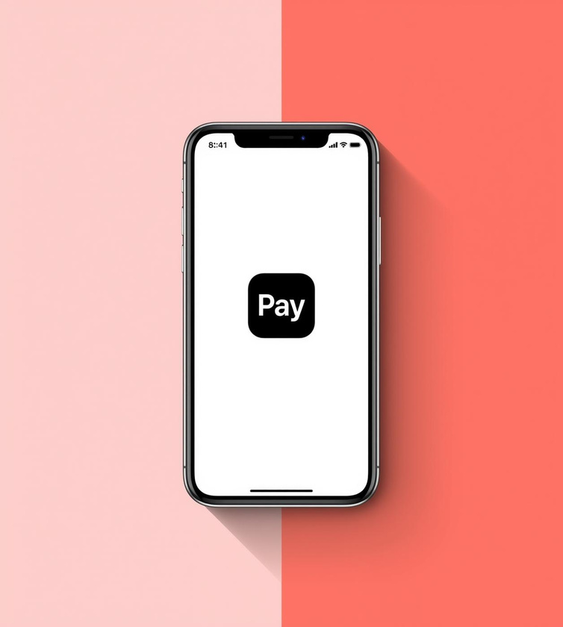
Popular Examples of M Commerce
Online shopping apps (Daraz, Amazon)
Mobile wallets (eSewa, Khalti, Paypal)
Food delivery apps (Foodmandu, Uber eats)
Ride sharing apps (Pathao, Uber)
Amazon App
Apple Pay
A leading platform for mobile shopping convenience.
Enables quick and secure mobile payment transactions.

Slide 8

Future Trends
Growth of mobile payments and digital wallets
Use of AI for personalized shopping
Faster transactions with 5G technology
Increased security with biometric authentication
Expansion of M-Commerce in rural areas

Slide 9

Summary
M Commerce is rapidly growing, offering significant convenience but also facing various challenges as technology

Slide 10
Thank You!!!

